Slide 1
_{workshop}
scrum

Slide 2
what is
is not a process or method
0. What is Scrum
Early 1990’s
SCRUM IS A FRAMEWORK
SCRUM VALUES
for developing, delivering, and sustaining complex products, within you can employ various processes and techniques.
Scrum team members have courage to do the right thing and work on tough problems.
Everyone focuses on the work of the sprint and the goals of the Scrum Team.
The essence of Scrum is a small team of people. Founded in Empirical process control theory and its powerful comes from experience and making decision based on what is known.
Transparency. Inspection. Adaptation.

Slide 3
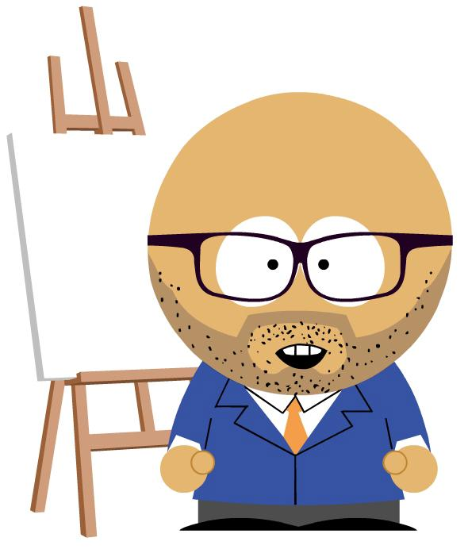
SCRUM TEAM
Product owner
Is responsible for maximizing the value of the product resulting from work of the Development Team.
1. scrum team
MANAGING THE PRODUCT BACKLOG
Is the sole person responsible of managing and sort the product backlog.
PRODUCT BACKLOG VISIBLE
Ensuring that PB is visible, transparent and clear to all, and shows what the Scrum Team will work on next.
UNDERSTANDING
Ensuring the Development Team understands items in the Product Backlog.

Slide 4
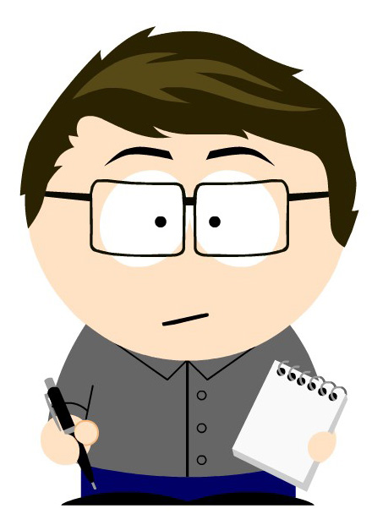
SCRUM TEAM
Scrum master
Is a servant-leader for the Scrum Team. Coaching the Development Team in organizational environments in which Scrum is not yet fully adopted and understood.
FACILITING
Scrum events as requested or needed.
COACHING
the Development Team in self-organization and cross-functionality.
REMOVING
impediments to the Development Team’s progress.

Slide 5
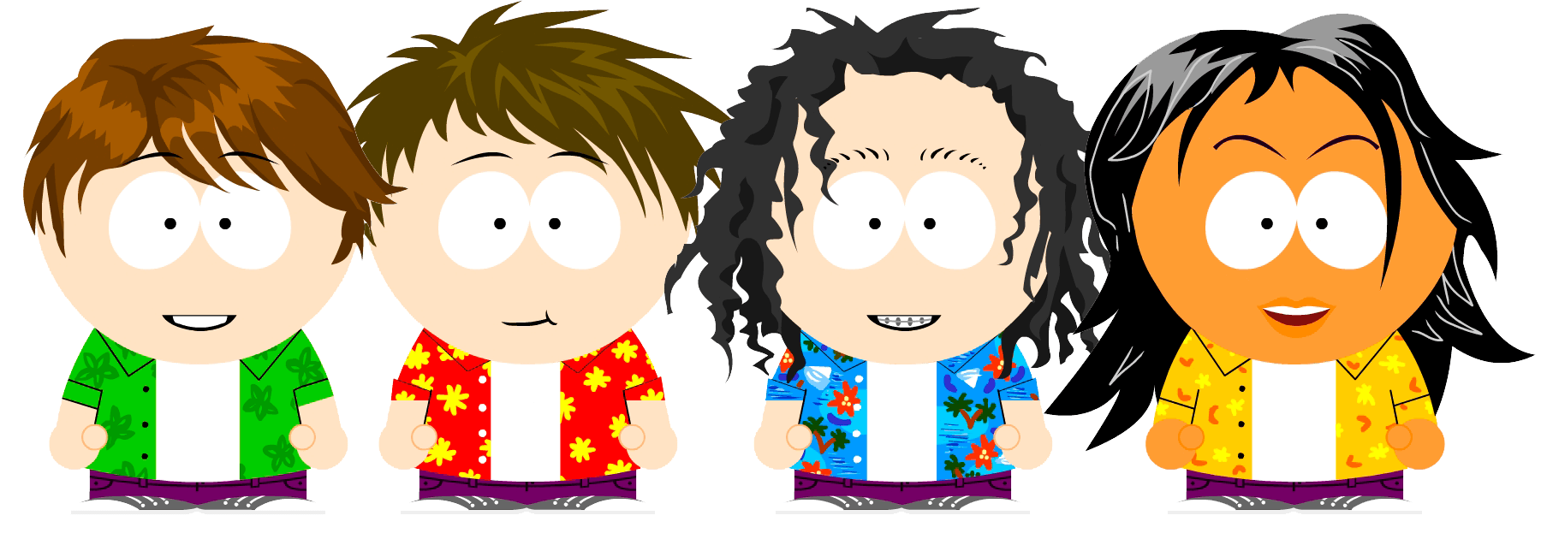
SCRUM TEAM
Development Team
Professionals who do the work of delivering a potentially releasable Increment of “Done” product at the end of each Sprint.
SELF-ORGANIZING
CROSS-FUNCTIONAL
They are self-organizing.
Development Teams are cross-functional, with all the skills as a team necessary to create a product Increment.
ARE EQUAL
SIZE
No titles for Development Team members.
Size of team: 3 – 9 people.

Slide 6
2. Events
Scrum
The heart of Scrum is a Sprint, a time-box of one month or less during which a “Done”, useable, and potentially releasable product Increment is created.
What can be delivered in the Increment resulting from the upcoming Sprint?
How will the work needed to deliver the Increment be achieved?
Sprint Planning
Sprint Goal is an objective.
Provides guidance to the Dev team.
It’s a plan created by the collaborative work of the entire Scrum Team.
Is time-boxed to a maximum of 8 hours for a one-month Sprint.
Notes:
To change the image behind the Mock up.
Select the layer - > Right Click -> Send to Back -> Delete the image -> Drag & Drop your Own Picture -> Send to Back (again)

Slide 7
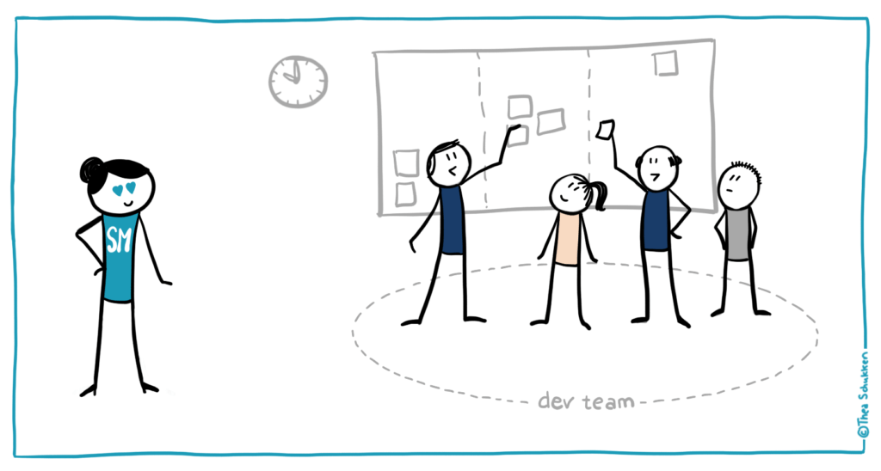
15-minutes time boxed
DEVELOPMENT TEAM REQUIRED
Daily Scrum
What did I do yesterday
What will I do today
Do I see any impediment
The Development Team uses the Daily Scrum to inspect progress toward the Sprint Goal and to inspect how progress is trending toward completing the work in the Sprint Backlog.

Slide 8
Sprint Review
Retrospective
4-hours for 1 month Sprints
3-hours per month of Sprint
Scrum and stakeholders.
The Product Owner explains what Product Backlog items have been Done and not.
Dev team show the work.
Get input to next Sprint Planning.
Inspect the last Sprint. People, relationships, process, tools.
Identify and order items.
Create a plan for implementing improvements.

Slide 9
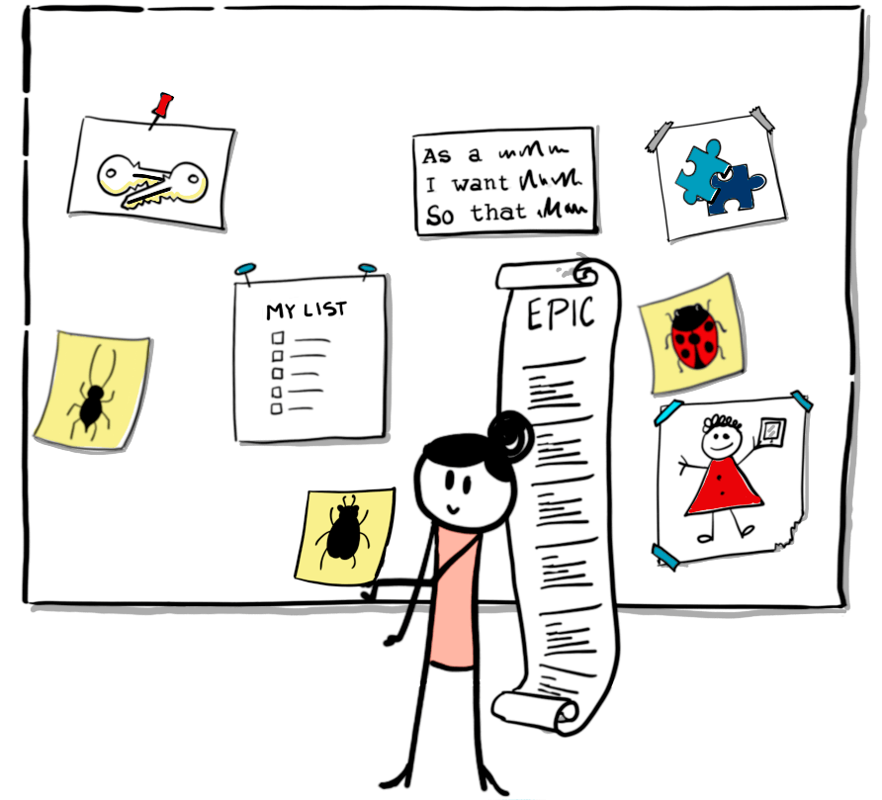
4. ARTIFACTS
Product Backlog
Is an ordered list of everything that is known to be needed in the product. Single source. Never complete.
Higher ordered items are usually clearer and more detailed than lower ordered ones.
Notes:
To change the image behind the Mock up.
Select the layer - > Right Click -> Send to Back -> Delete the image -> Drag & Drop your Own Picture -> Send to Back (again)

Slide 10
Increment
Sprint Backlog
Is the sum of all the Product Backlog items completed during a Sprint and the value of the increments of all previous Sprints.
At the end of a Sprint, a new Increment must be Done.
Is the set of Product Backlog items selected for the Sprint .
PLAN FOR DELIVERING
Definition of Done DOD
Although this may vary significantly per Scrum Team, members must have a shared understanding of what it means for work to be complete, to ensure transparency.
This is the definition of “Done” for the Scrum Team and is used to assess when work is complete on the product Increment.
Notes:
To change the image behind the Mock up.
Select the layer - > Right Click -> Send to Back -> Delete the image -> Drag & Drop your Own Picture -> Send to Back (again)

